Slide 1
What to expect
Yin Yoga 60/90 mins class
By Margarita Zilberman
www.ritaz.yoga

Slide 2
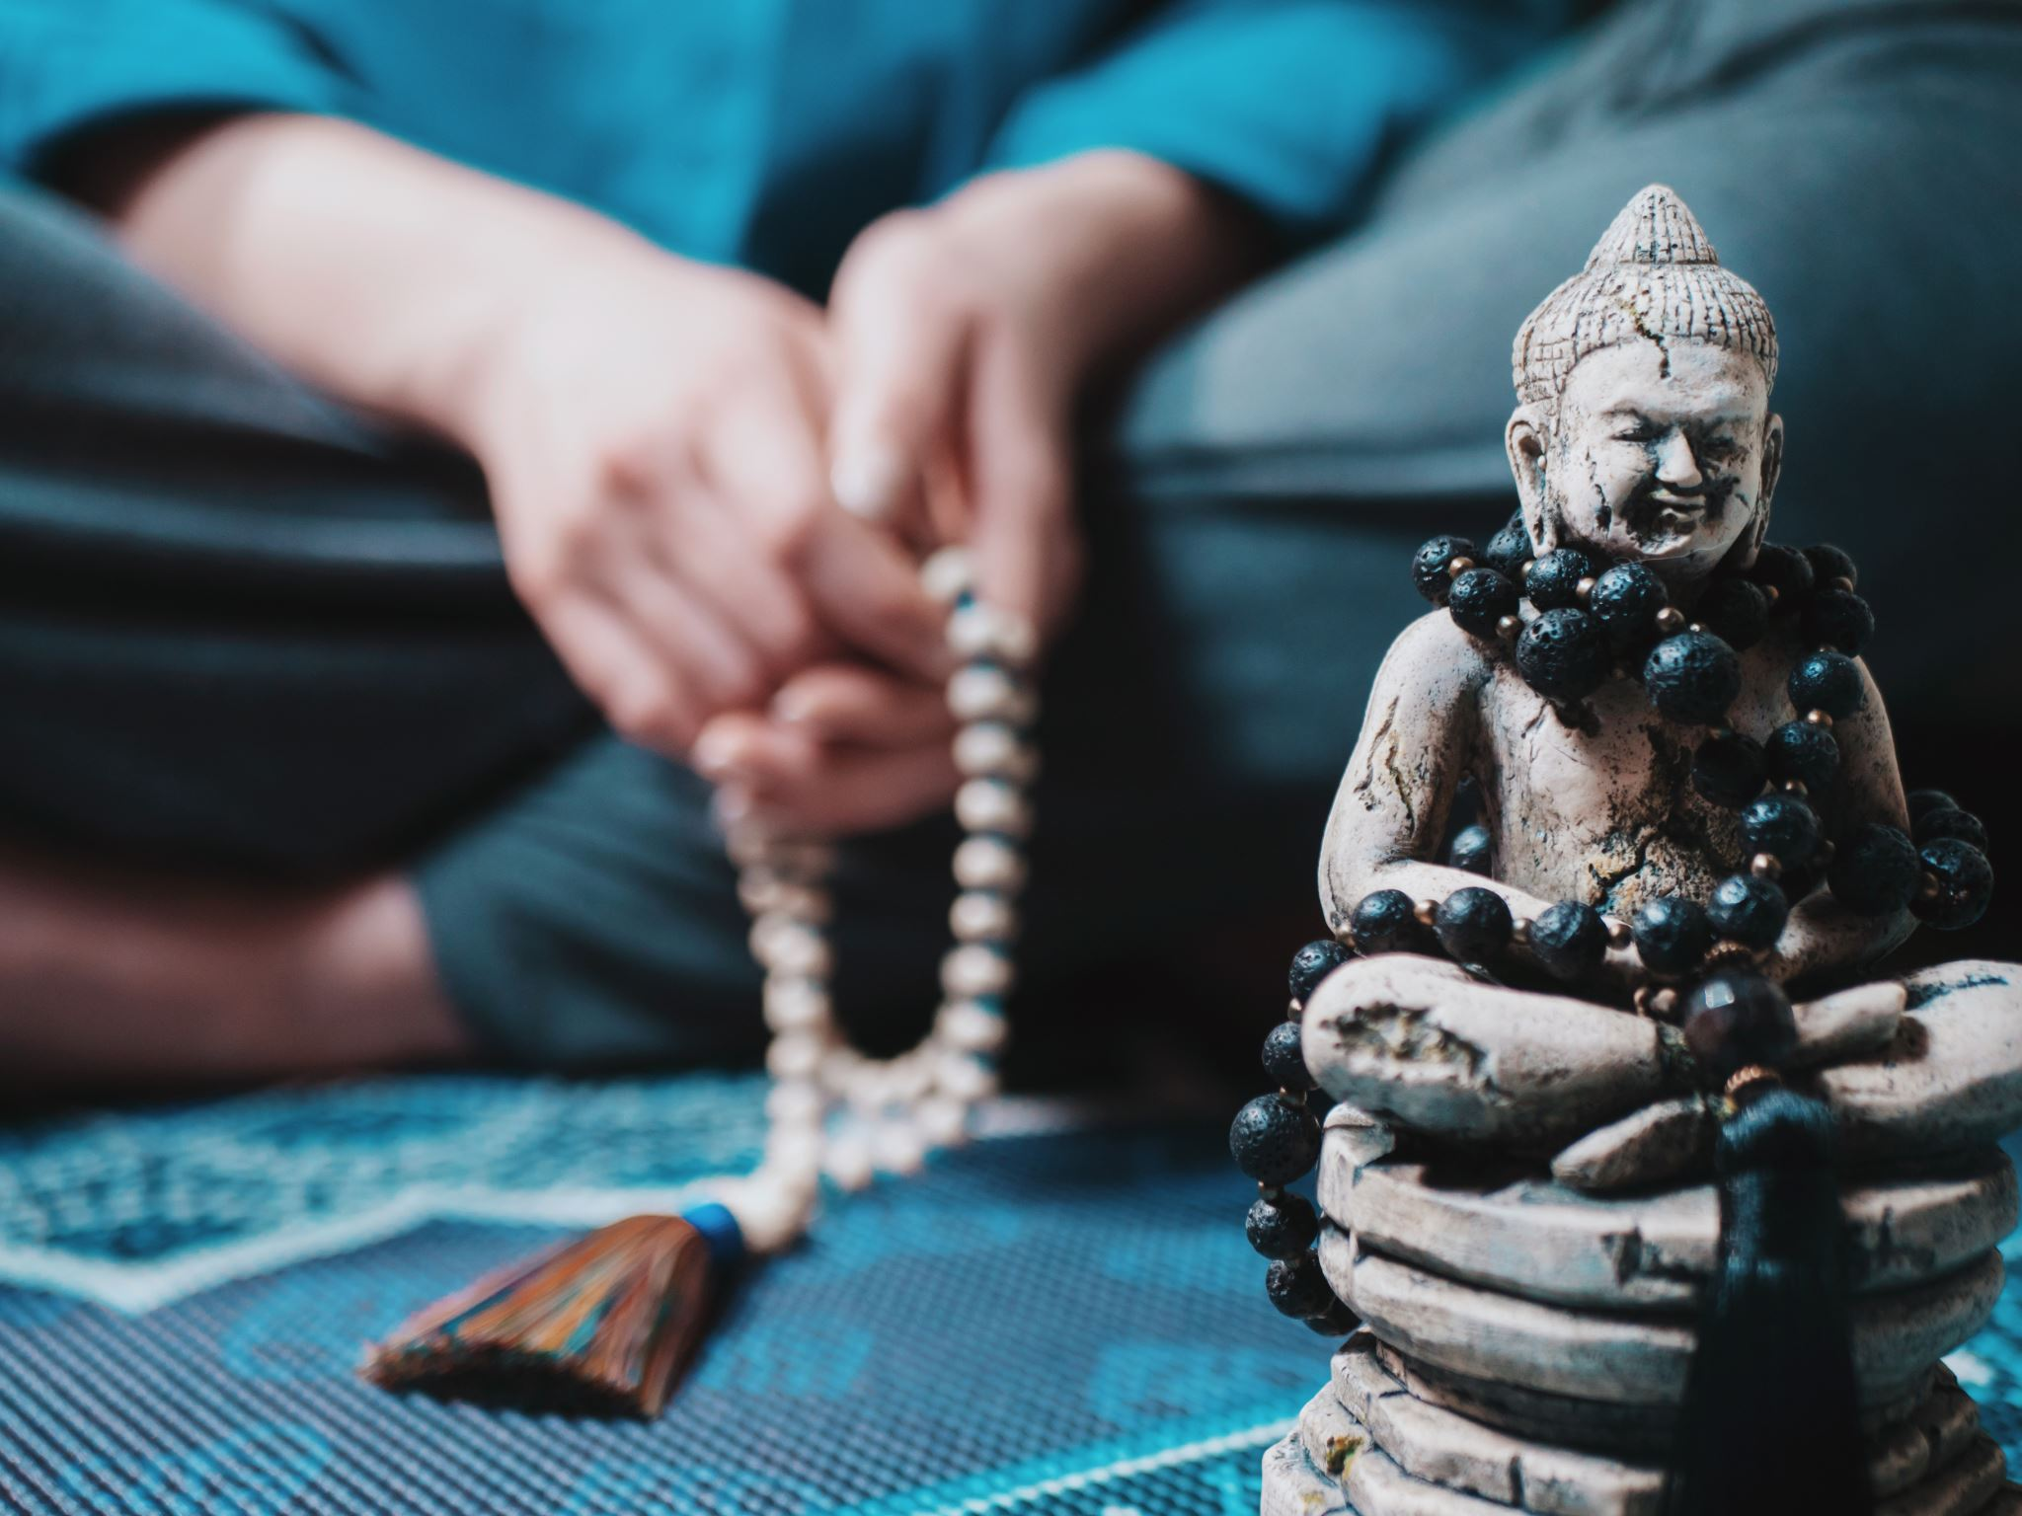
3-5 mins holds
Yin yoga is a very slow-paced and meditative style of yoga that consists of mostly seated postures that need to be held for a longer period of time, most commonly 3-5 mins.
By Margarita Zilberman
www.ritaz.yoga

Slide 3
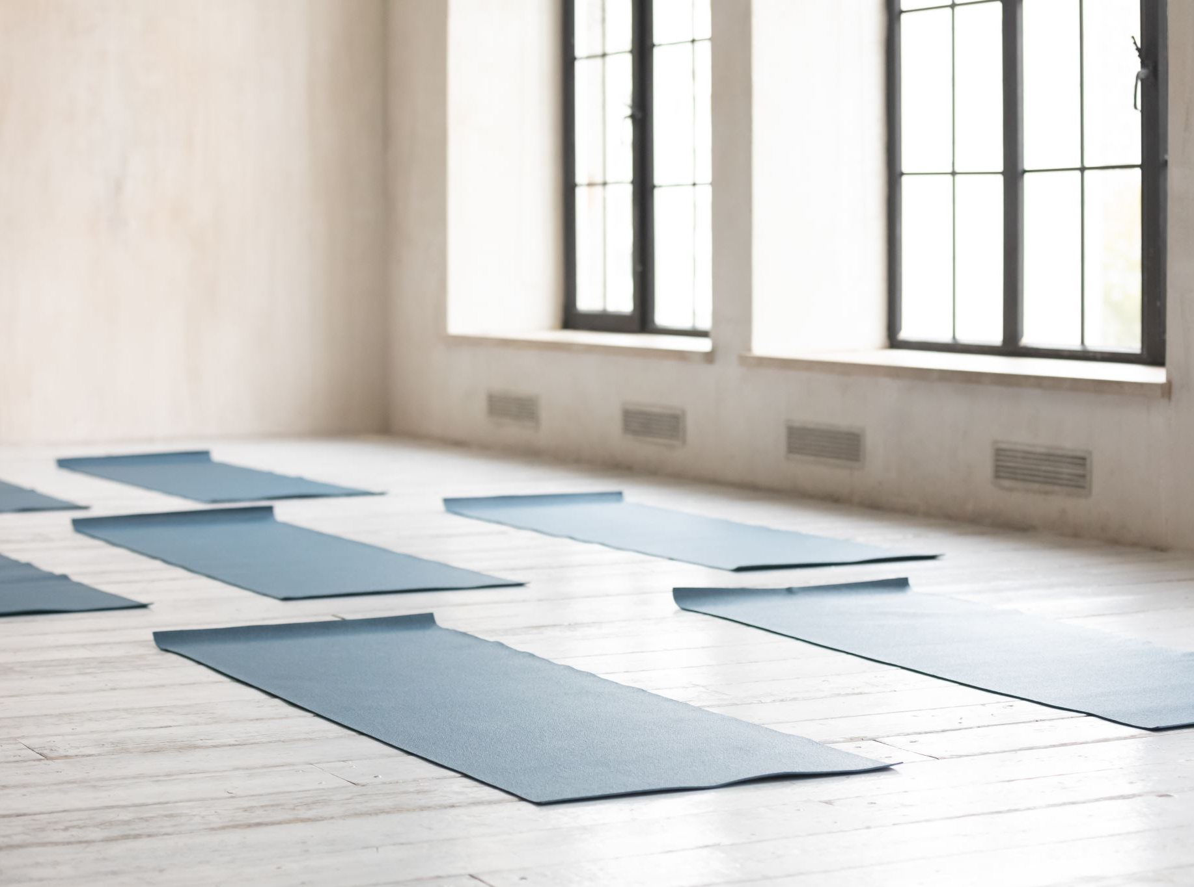
Slow-paced and meditative
This meditative class focuses on the deeper stretching into the body.
The hour-long practice is a great intro to yin yoga if you are new to it.
By Margarita Zilberman
www.ritaz.yoga

Slide 4
Deeply stretches into the body
Yin stretches deeply into the body, into the connective tissues and fascia.
Yin yoga postures gently stretch the connective tissues that form our joints, we can exercise the joints if we do so intelligently.
By Margarita Zilberman
www.ritaz.yoga

Slide 5
Focuses on the connective tissue, fascia and joints
Each class sequence is unique and focused on different parts of the body. Lessons start with a short meditation and end with a cosy Savasana (relaxation).
By Margarita Zilberman
www.ritaz.yoga

Slide 6
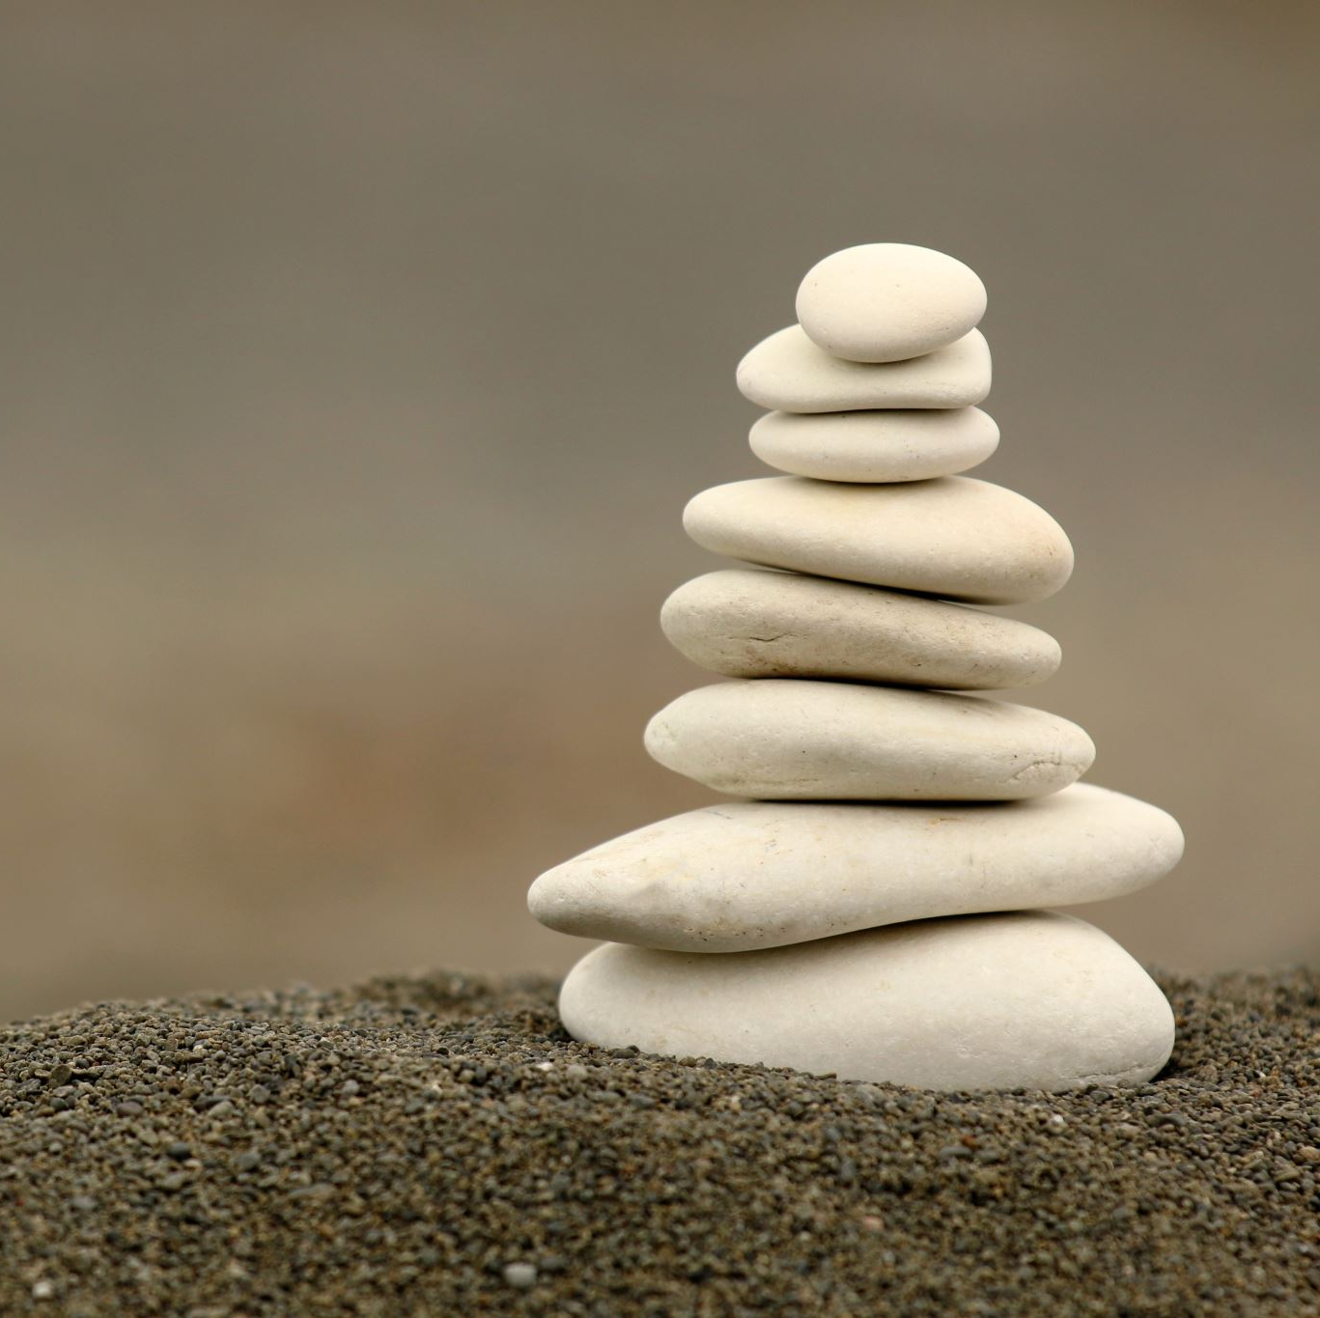
This type of yoga might seem new to us.
Our modern world is very "yang" in nature, but there should always be a balance. Yin yoga & meditation can help bring balance to our overly busy lifestyles.
By Margarita Zilberman
www.ritaz.yoga

Slide 7
Yin Yoga helps to:
Increase
increase flexibility
Improve
improve joint health
Achieve
achieve a greater sense of inner peace and calm
Relieve
relieve stress
By Margarita Zilberman
www.ritaz.yoga

Slide 8
With love & light to you all
By Margarita Zilberman
www.ritaz.yoga

